Slide 1
Databases
Topic 12: Summary
Notes:
NCC Education - Title Master

Slide 2
The Unit Roadmap
1 | Introduction to the unit and database fundamentals
2 | Entity Relationship Modelling 1
3 | Entity Relationship Modelling 2
4 | The Relational Model
5 | Normalisation
6 | SQL
7 | Database Design
8 | Supporting transactions
9 | Database Implementation
10 | Database Security and Cloud Databases
11 | Big Data and Post-Relational Databases
12 | Summary

Slide 3
Scope and Coverage
This topic will cover:
  Summary of unit
  Clarification of unit material and related issues as identified by students
  Identify links with other units/subject areas
Notes:
NCC Education - Slide Master

Slide 4
Learning Outcomes
By the end of this topic, students will be able to:
  Recognise the key concepts they have studied on the unit
  Have clarification of the unit material
  Recognise links to other subject areas

Slide 5
Definitions of Database
  Key features of a database:
  Organised
  Logically related
  Contains data
  Able to store and manipulate data

Slide 6
File Processing Systems
    Data are separated and isolated.
    Data are often duplicated.
    Application programs are dependent on file formats.
    Files are often incompatible with one another.
    It is difficult to represent data in a user’s perspective.

Slide 7
Features of the Database Approach
    Integrated data
    Reduced data duplication
    Program/data independence
    Easier representation of users’ perspectives
    Database systems are self-describing.
    Database systems maintain program-data independence.
    A database is a model of a model.

Slide 8
Data and Information
  Traditionally, there has been a distinction made between ‘data’ and ‘information’.
  Data are ‘raw facts’.
Baker, Kenneth | 19.01.80 | 98778373
Bagum, Ammena | 01.02.81 | 97327627
Ako, Sarah | 08.08.81 | 98737373
Finkle, Clive | 09.09.81 | 93838383
Mc Farren, Debra | 01.01.80 | 98383837
Sinseros, Douglas | 27.05.80 | 99344222

Slide 9
Class list for Databases Module
Autumn Semester 2010
Student Name Student ID Date of Birth
Kenneth Baker 98778373 19th Jan 1980
Ammena Bagum 97327627 1st Feb 1981
Sarah Ako 98737373 8th Aug 1981
Clive Finkle 93838383 9th Sep 1981
Debra McFarren 98383837 1st Jan 1981
Douglas Sinseros 99344222 27th May 1980
Information
  Data that has been processed and given meaning

Slide 10
Meta-Data
  Meta-data is data that is about data.
  It is the way in which the database keeps information about its own structure.
  It is important in understanding how data can be independent of applications in the database approach.

Slide 11
Discussion Session
  Why is meta-data important?
  What purpose does it serve?
  How does it differentiate databases from older file processing systems?

Slide 12
Data-Types
  What are data-types?
  What data-types are generally available in SQL?

Slide 13
Definitions of Key Parts of ER
  Entity
  Attribute
  Relationship

Slide 14
ERD from an Example Problem
A GARDENING COMPANY
The company hires out workers as they need to.
Workers in the town stay in lodgings. A lodging may have many workers in it. We are only concerned with the workers current lodging. Workers possess certain skills such as ‘Tree Surgery’, ‘Garden Design’. They may have more than one skill.

Slide 15
Solution
worker
worker_
skill
skill
1
0...*
0...*
1
0...*
Where did the ‘worker skill’
entity come from?
1
lodging

Slide 16
Key Concepts of Relational Model
  Relations and tables
  Attributes
  Domains
  Tuples and rows
  Primary key
  Foreign key

Slide 17
Quiz
  Which statement accurately describes the relationship between the elements of a relational database?
  A domain is a unique identifier for a tuple within a relation, serving as the primary key.
  A foreign key is a set of attributes within a tuple that uniquely identifies a row in another table.
  A primary key is a collection of relations that ensures referential integrity between two tables.
  Attributes are the columns in a table, and tuples are the rows; a primary key uniquely identifies each tuple, and a foreign key references a primary key in another table.

Slide 18
Checkpoint Summary
File processing system
Features of the database approach
Data vs information
Metadata
Data types
ERD

Slide 19
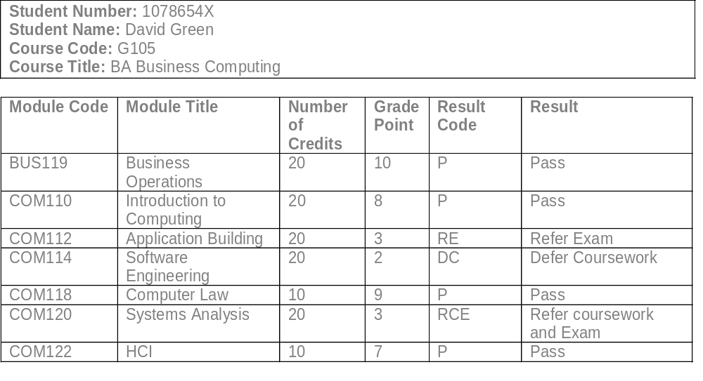
The Document

Slide 20
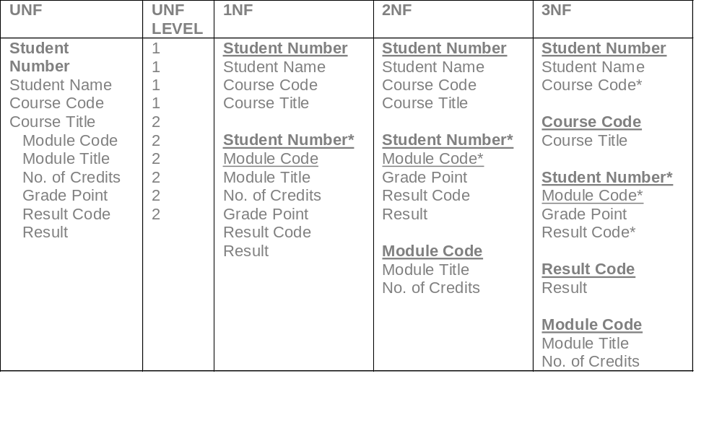
Normalised to 3NF

Slide 21
SQL
Create
Insert
Update
Delete
Select

Slide 22
Database Development
  Database development – wider context involving many disciplines
  Key concept of requirements gathering
  Database design – part of development process

Slide 23
Database Design
Moving from a set of requirements
To implementing these with Database Technology

Slide 24
Competed CRUD Matrix
Transaction/Relations | A | B | C | D | E | F | G | H
Boat | C U D |  |  |  | R |  | R
Customer |  | C U |  |  |  | R | R
Rental |  |  | C |  |  | R | R | R
Damage |  |  |  | C |  | R | R

Slide 25
De-Normalisation
  We have created a database following all the rules of normalisation...
  Now we can break them to make the database work quicker and perform better...

Slide 26
Server
Applications
Internet
Database
Network
Other systems
Server

Slide 27
Types of Constraints
  Referential integrity
  Propagation constraints
  Domain constraints
  Table constraints
  Plus..
    Constraint violation

Slide 28
Links with Other Units and Subject Areas
  Systems Analysis
    L4 Object-Oriented System Analysis and Design
  Software Engineering
  Web development
    L4 Front End Web Development
    L5 Back End Web Development
  Introduction to Data Science and Big Data

Slide 29
Assessments
Examination (40%)
Assignment (60%)

Slide 30
Assessments - Examination
Examination (40%)
  Practice with the sample exam paper and familiarise yourself with the format and types of questions asked if you haven’t done so.
  Practice SQL DDL and DML.
  Make a list of topics you find challenging and seek clarification from tutors well before the exam.

Slide 31
Assessments - Assignment
Assignment (60%)
  Practice with the sample assignment if you haven’t done so.
  Ensure your database design and queries meet all the given specification and requirements.
  Write clean and well-commented SQL.
  Format your code consistently.
  Provide clear documentation of your design choices, and comment your SQL as required.

Slide 32
Learning Outcomes – Have We Met Them?
By the end of this topic, students will be able to:
  Recognise the key concepts they have studied on the unit
  Have clarification of the unit material
  Recognise links to other subject areas

Slide 33
Topic Summary
File processing system
Features of the database approach
Data vs information
Metadata
Data types
ERD
Normalisation
Database design and implementation
CRUD
De-Normalisation
Constraints

Slide 34
Topic 12 – Summary
Any Questions?
Notes:
NCC Education - End Slide Master

